Slide 1
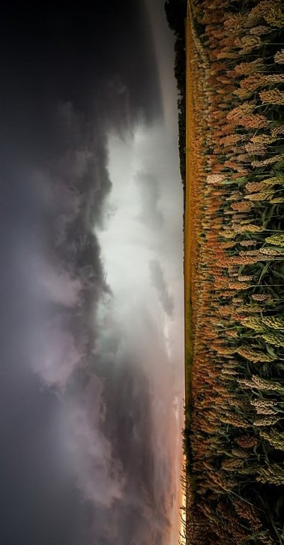
Project Name
GreenThumbWeather
Submitted By: Rishabh Rawat

Slide 2
Theme: IT in Agriculture
Key Objectives
Offering real-time weather update
Aggregate global agricultural news
Providing a versatile helper page
Delivering accurate and timely information to farmers

Slide 3
Technologies Used
01
HTML, CSS & JavaScript
We utilized HTML, CSS, and JavaScript to build the website. HTML provided the structure, CSS facilitated the design, and JavaScript made the website interactive.
We integrated OpenWeather, NewsAPI, and Wikipedia API. This integration ensures that our users receive real-time weather updates, global agricultural news, and versatile information.
We designed a user-friendly interface to allow easy navigation for users. The design is also responsive, adapting to various devices.
02
API Integration
03
User Interface Design

Slide 4
Services Offered
01
Real Time Weather Forecast
Users can access up-to-the-minute weather forecasts through our platform. This feature helps farmers plan their activities based on real-time weather conditions.
Stay informed with the latest agricultural news from around the world. Our platform aggregates global news, ensuring users are updated on industry trends and developments.
Our versatile helper page serves as a one-stop solution for various queries. Users can search for information, tips, and assistance related to agriculture, making it a valuable resource.
02
Global Agriculture News
03
Versatile Helper Page

Slide 5



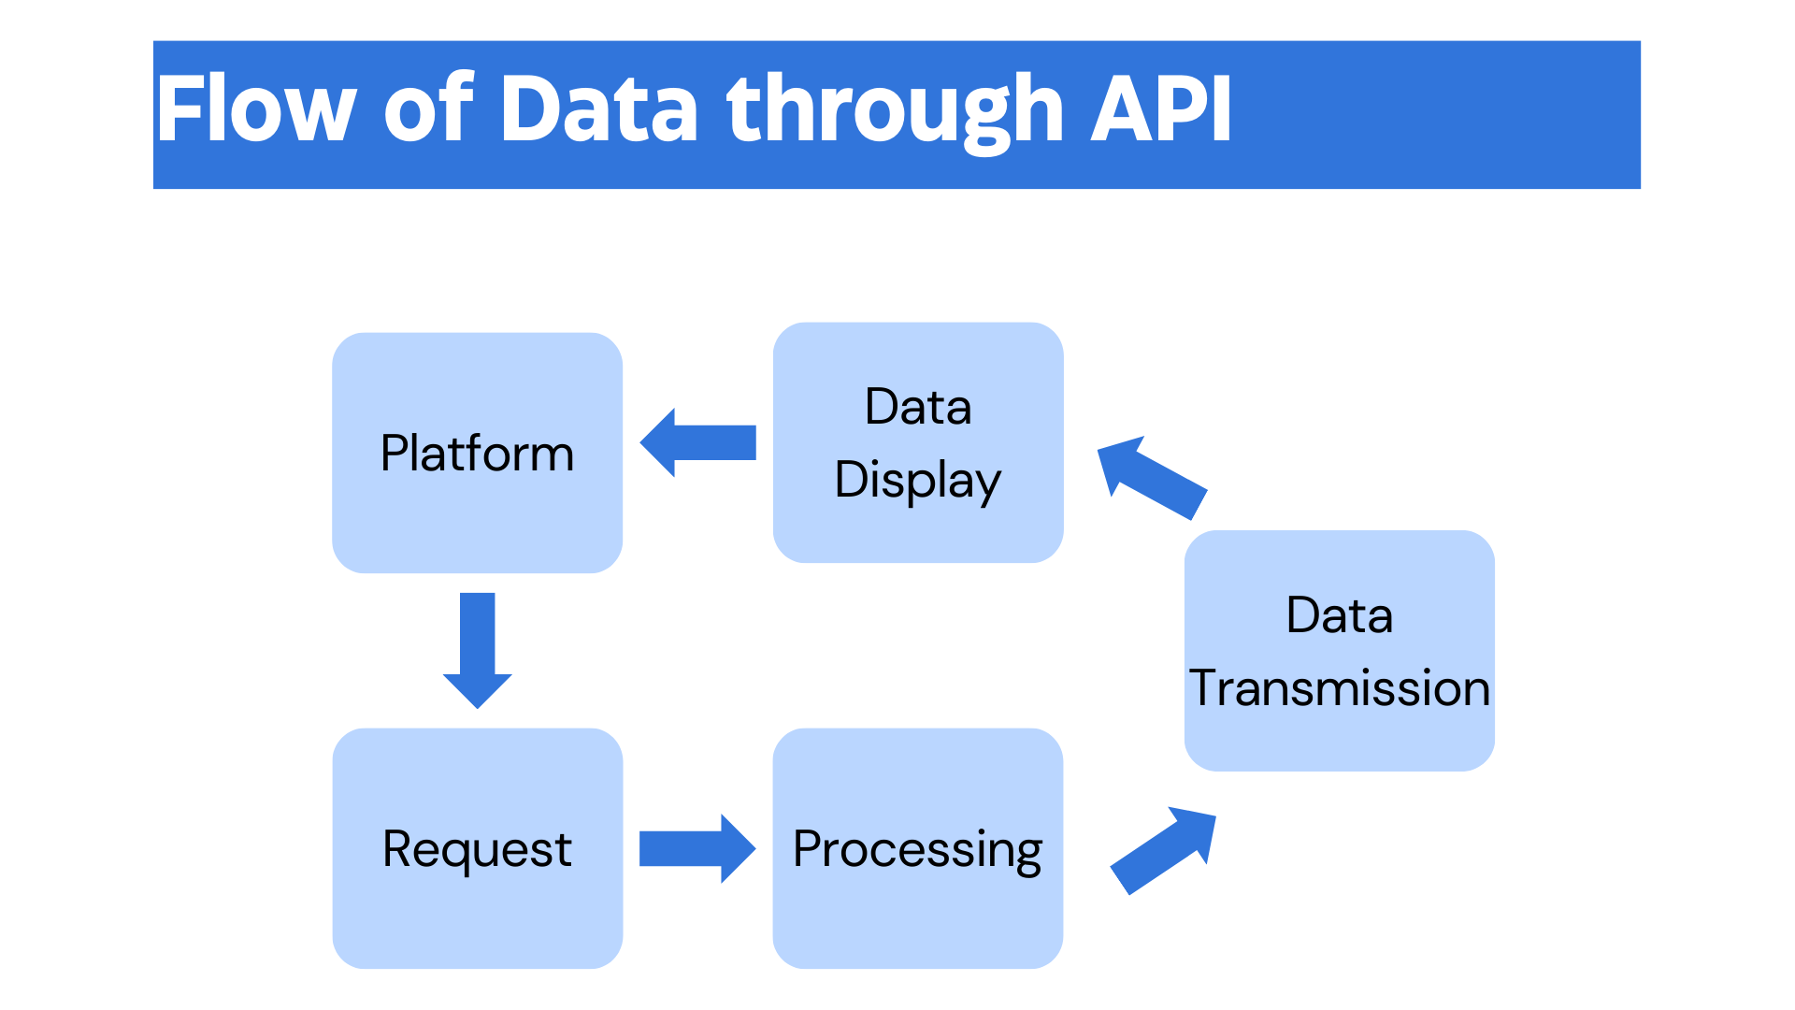
API Integration
Our platform is seamlessly connected with OpenWeather, NewsAPI, and Wikipedia API.
OpenWeather API ensures accurate and timely weather forecasts.
NewsAPI helps aggregate news from various sources, providing a comprehensive view of the agricultural landscape.
Wikipedia API contributes to the helper page, offering a wide range of information for users' queries.

Slide 6
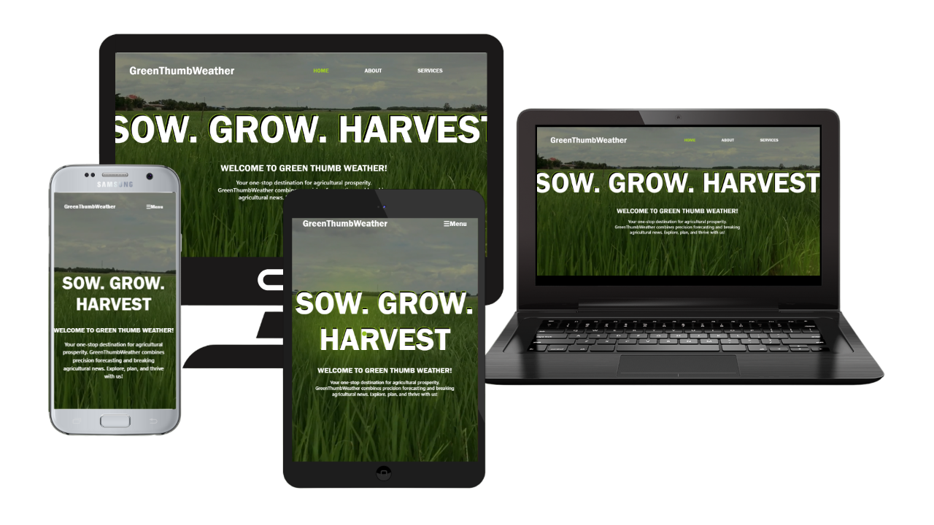
User Interface Design
Our website design focuses on simplicity and a user-friendly experience.
Responsive Design: Our platform is designed to adapt seamlessly to various devices, including desktops, tablets, and smartphones.
User Accessibility: Ensuring a consistent and enjoyable experience for users regardless of the device they use.

Slide 7
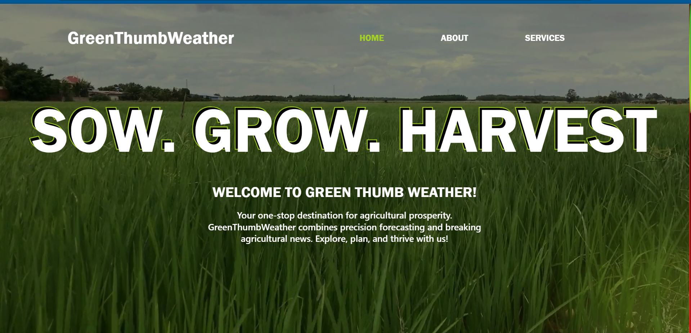
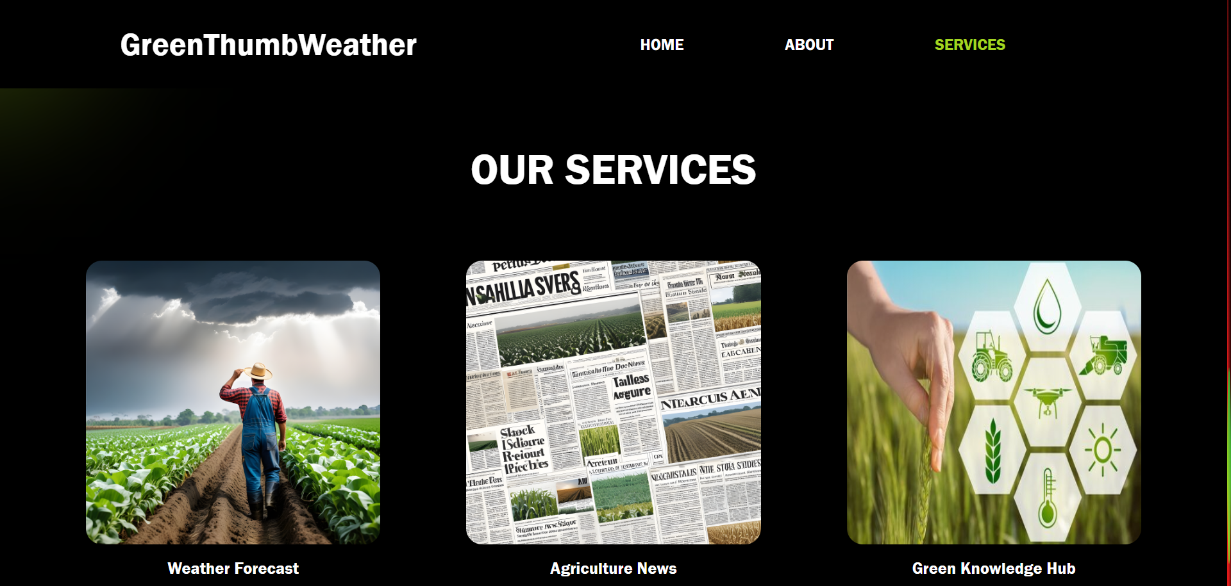
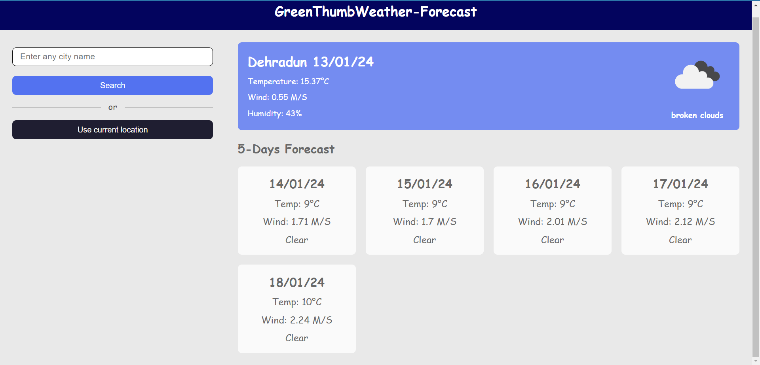
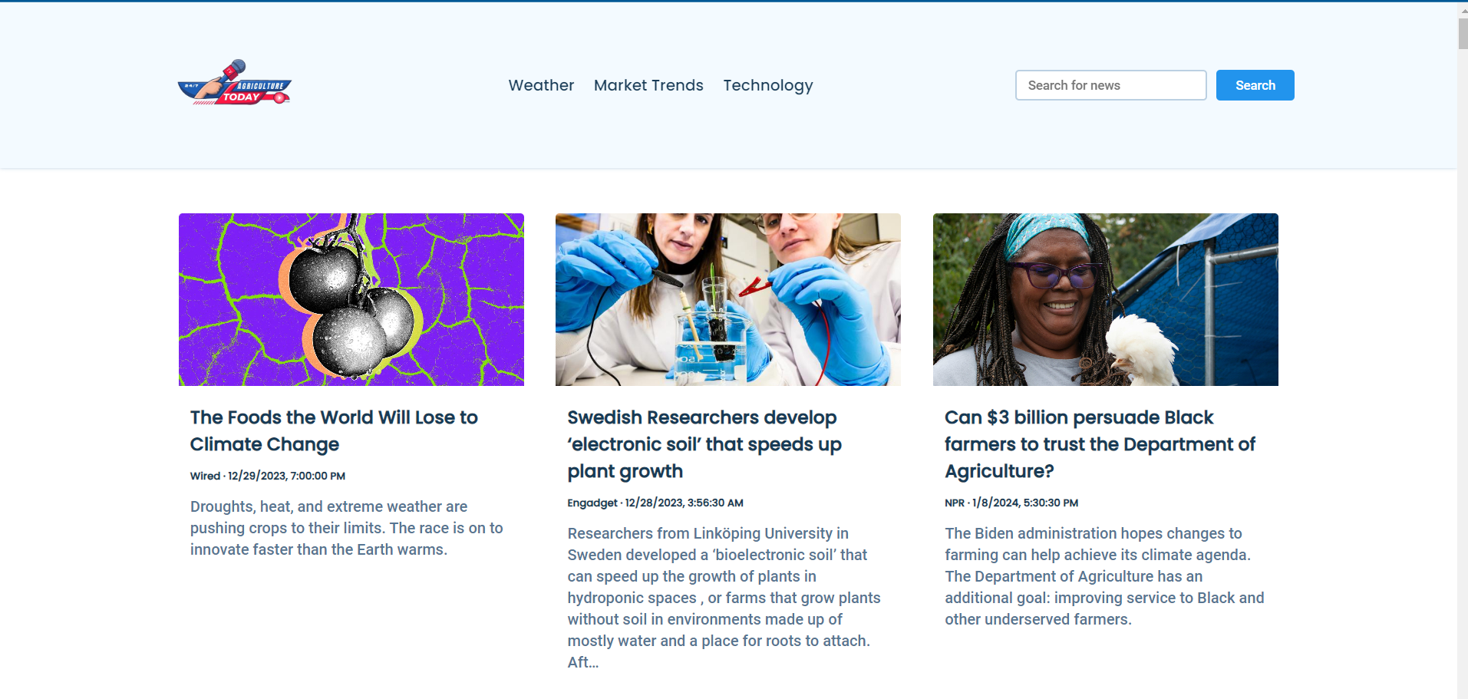
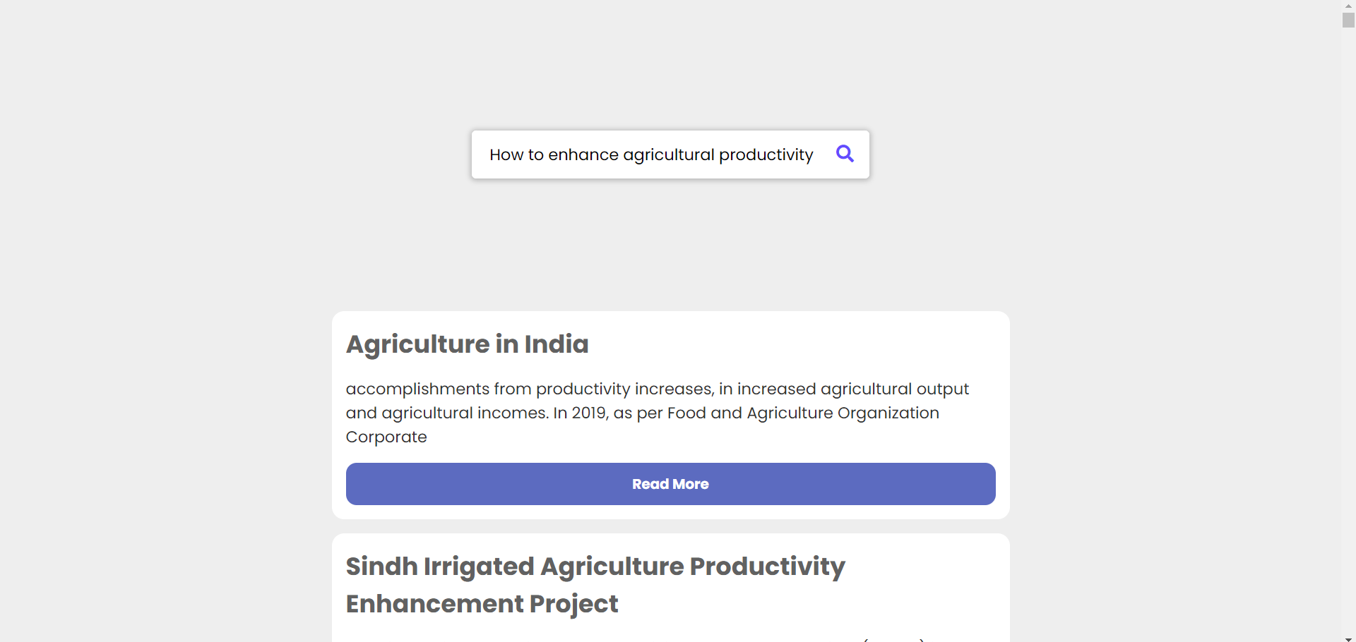
User Instructions & Overview
This slide provides overview and guidance on how users can navigate through different sections of the website. It covers key features, buttons, and tabs, ensuring an easy and enjoyable browsing experience.

Slide 8
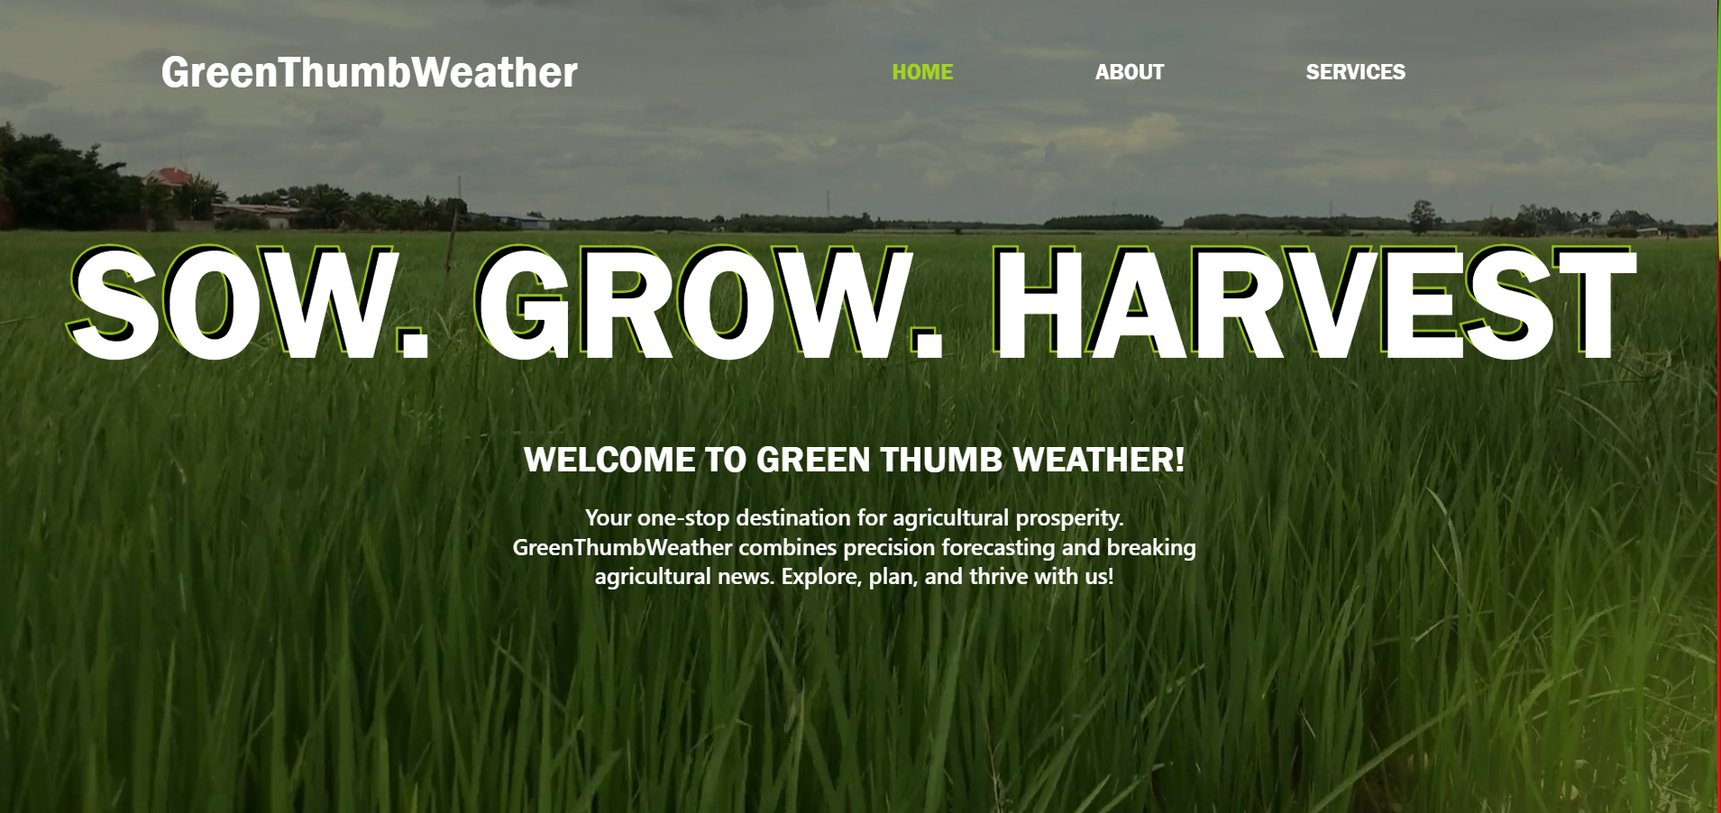

Slide 13

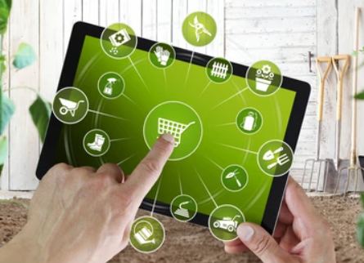
Future Enhancements
01
Expanded API Integration
Enhance the platform's capabilities by integrating additional APIs. Explore possibilities to include more diverse data sources for a richer user experience.
Introduce an online marketplace for agricultural goods, connecting farmers directly with consumers. Enable buying and selling of products for a comprehensive agricultural ecosystem.
02
E-Commerce Integration

Slide 14
